Slide 1
OOP Module 1 Part 13
Prepared by
Renetha J.B.
Prepared by Renetha J.B.
‹#›

Slide 2
Topics
Access Control specifiers
Prepared by Renetha J.B.
‹#›

Slide 3
Access Control Specifiers
Through encapsulation, we can control what parts of a program can access the members of a class.
  By controlling access, you can prevent misuse.
How a member can be accessed is determined by the access specifier that modifies its declaration
Java’s access specifiers are
  public
  private
  protected
  default
Prepared by Renetha J.B.
‹#›

Slide 4
Access Control(contd.)
When a member of a class is modified by the public specifier, then that member can be accessed by any other code. (ACCESSIBLE TO ALL)
  public int i;
When a member of a class is specified as private, then that member can only be accessed by any members of the same class.
  private int a;
Prepared by Renetha J.B.
‹#›

Slide 5
Access Control(contd.)
When a member of a class is specified as protected , then that member can be accessed within the package and by any of its subclasses.
protected char c;
When no access specifier is there, then its access specifier is default.
  It can be accessed within its own package, but cannot be accessed outside of its package
  int c;
Prepared by Renetha J.B.
‹#›

Slide 6
Access specifier-E.g.
class A{
  public int i;
  private double j;
  protected char c;
  float f; //default access
  public int myMethod(int a, char b) //public method
  { //..
  }
}
Prepared by Renetha J.B.
‹#›

Slide 7
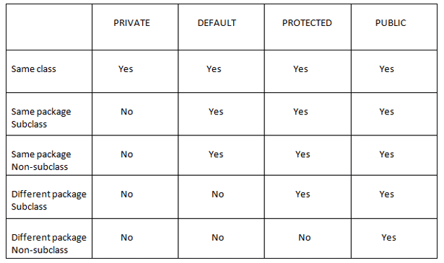
SAME CLASS
SAME PACKAGE,
SAME PACKAGE
,
ANY SUBCLASS
ALL
Prepared by Renetha J.B.
‹#›

